Slide 1
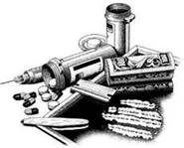
The New High
Drug Identification and Awareness

Slide 2
National Survey on Drug Use and Health (NSDUH)
24.6 million Americans 12 or older used an illicit drug in past month
19.8 million current marijuana users
6.5 million 12 or older had used prescription drugs without prescription
1.3 million used hallucinogens in past month.

Slide 3
National Survey on Drug Use and Health (NSDUH)
Cocaine users 12 or older was 1.5 million.
595,000 current methamphetamine users
Drug use highest among people in late teens and twenties
22.6 percent of 18- to 20-year-olds reported using an illicit drug in the past month.

Slide 4
National Survey on Drug Use and Health (NSDUH)
1.7 million adults aged 18 on parole or supervised release from prison during past year.
27.4 percent were current illicit drug users
20.4 percent reporting current use of marijuana
12.1 percent current nonmedical use of psychotherapeutic drugs.
gs

Slide 5
NSDUH and Prison
rates higher than adults not on parole or supervised release during past year
9.3 percent illicit drug use 7.5 percent current marijuana use, 2.4 percent nonmedical use of psychotherapeutic drugs
Rates higher than those not on probation during past year 9.0 percent illicit drug use, 7.3 percent current marijuana use, and 2.3 percent for nonmedical use of psychotherapeutic drugs

Slide 6
PERFORMANCE OBJECTIVES
PERFORMANCE OBJECTIVES
Using the information provided identify illicit substances according to the effects and appearance of each substance.
Using offender behaviors, identify the illicit substance which causes the behavior, according to the information in the manual.

Slide 7
GUIDED PRACTICE
Identify concerns related to drug use
Record your answers on the easel pad
Select a spokesperson to share your answers with the class.
You have 5 minutes

Slide 8
PRESCRIPTION PILLS
Opioids (for pain)
Hydrocodone (Vicodin)
Oxycodone (OxyContin)
Oxymorphone (Opana)
Propoxyphene (Darvon)
Hydromorphone (Dilaudid)
Meperidine (Demerol)
Diphenoxylate (Lomotil)

Slide 9
PRESCRIPTION PILLS
Central Nervous System (CNS) Depressants (for anxiety and sleep disorders) (also known as Barbituates)
Pentobarbital sodium (Nembutal)
Diazepam (Valium)
Alprazolam (Xanax) (Benzodiazepine category)

Slide 10
PRESCRIPTION PILLS
Stimulants (for ADHD and narcolepsy)
Dextroamphetamine (Dexedrine),
Methylphenidate (Ritalin and Concerta)
Amphetamines (Adderall)

Slide 11
Antipsychotics
Strictly Controlled
Very limited prescriptions
Zyprexa
Seroquel
Haldol

Slide 12
PRESCRIPTION PILLS

Slide 13
PRESCRIPTION PILLS STREET NAMES
oxy,
cotton,
blue,
40,
80
OxyContin
Barbs
Candy
Downers
Phennies
Reds
Red Birds
Sleeping pills
Tooies
Tranks
Yellows
Yellow Jackets

Slide 14
Opiod effects
Feelings of euphoria
Pain relief
Drowsiness
Sedation
Lethargy
Paranoia
Nausea
Confusion
Constipation
Shifting or dramatically changing moods
Social withdrawal/isolation
Depressed breathing
pinprick or pinpoint pupils

Slide 15
Central Nervous System Depressant effects
Slow brain function
Slowed pulse and breathing
Lowered blood pressure
Poor concentration
Confusion
Fatigue
Dizziness
Slurred speech
Fever
Sluggishness
Visual disturbances
Dilated pupils
Disorientation, lack of coordination
Depression
Difficulty urinating
Addiction

Slide 16
Stimulant Effects
anxiety
paranoia
dangerously high body temperatures
irregular heartbeat
seizures.
hostility
exhaustion,
apathy
depression

Slide 17
Marijuana
Most common substance abused in the world.
Responsible for about 17 percent (322,000) of all admissions to treatment facilities in the United States
Starting marijuana by age 14 is common
Roughly 7,800 new users per day
Daily use of marijuana increased from 5.1 million persons in 2007 to 8.1 million persons in 2013.
Roughly 1 of 16 high school seniors smoke marijuana daily.

Slide 18
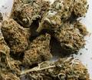
Marijuana (Cannabis Sativa)
brown or gray mixture of dried, shredded leaves, stems, seeds and flowers.

Slide 19
List of Marijuana names
In your group
List common names for marijuana
Record your answers on easel pad
select a spokesperson
You have 5 minutes

Slide 20
Marijuana street names
weed,
pot,
herb,
bud,
dope,
spliff,
reefer,
grass,
ganja,
420,
chronic,
Mary Jane,
gangster,
boom,
skunk.

Slide 21
Marijuana methods of use
Mix in food (edibles), such as brownies, cookies, or candy
brew as a tea.
smoking THC-rich resins (dabbing)
Using THC extracts including
hash oil or honey oil—a gooey liquid
wax or budder—a soft solid with a texture like lip balm
shatter—a hard, amber-colored solid

Slide 22
Marijuana effects
problems with memory a
distorted perception
difficulty thinking/ problem solving;
loss of coordination
increased heart rate,
anxiety,
bloodshot eyes,
dry mouth.
Panic attacks,
paranoia and psychosis
hallucinations
Loss of sense of personal identity
Lowered reaction time
Sexual problems (for males)
likely to contract STD (for females)

Slide 23
HASHISH
Similar to marijuana
produced from the same plant.
Smoked in a joint with tobacco or marijuana.
Smoked in a pipe or bong (water pipe)
Baked into food.

Slide 24
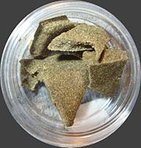
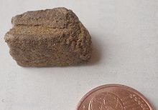
HASHISH
most commonly light to dark brown sometimes green, yellow, black or red

Slide 25
Hashish Effects
Happy
Relaxed
Feeling silly
Hallucinations may include strange colors or patterns
Paranoia
Problems with memory and learning;
Distorted perception
Loss of coordination and motor skills;
Increased heart rate,
Anxiety,
Bloodshot eyes,
Dry mouth.
Impaired Reaction time
Panic attacks

Slide 26
COCAINE
Highly addictive central nervous system stimulant
Snorted, injected, or smoked.
Street names:
Coke
Snow
Flake
Blow

Slide 27
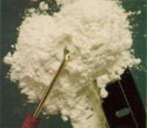
COCAINE
Appears as a white crystalline powder

Slide 28
Cocaine Effects
Euphoria
Increased Energy
Increased body temperature
High blood pressure
Increased heart rate
Grinding of teeth
Excessive movement
Agitation
Nose Bleed

Slide 29
Crack
Cocaine processed with baking soda or ammonia
Transformed into more potent "rock" form which can be smoked.
Name refers to the crackling sound heard when heated and smoked.
Highly addictive
Inexpensive to produce and buy

Slide 30
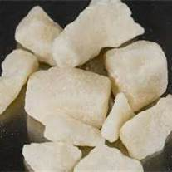
Crack
Appears as yellowish-white rock

Slide 31
Crack Street Names
Rock
Hard Rock
Base
Kryptonite
Sugar Block
Apple Jacks

Slide 32
Methods of Use
smoked through a glass hand pipe or water pipe.
Reports of drug being injected or even snorted
Some users combine crack cocaine with heroin, marijuana, and other types of drugs in order to create different, more intense effects.

Slide 33
“Crack” Effects
Increased blood pressure and heart rate
Constricted peripheral blood vessels
Rapid breathing
Dilated pupils
Hyper-stimulation
Intense euphoria
Decreased appetite
Anxiety and paranoia
Aggressive behavior
Depression
Intense drug craving
Sudden death

Slide 34
Prolonged Use Effects
Severe depression
Irritability and mood disturbances
Aggressive behavior
Delirium or psychosis
Tolerance and addiction
Auditory and tactile hallucinations
Heart attack and heart disease
Stroke
Respiratory failure
Brain seizures
Sexual dysfunction
Reproductive damage and infertility
Increased frequency of risky behavior
Death

Slide 35
Combining Cocaine
Chronic - marijuana laced with cocaine or crack
Dusting - sprinkling cocaine powder on other smokable drugs or on cigarettes
Speedballing - using cocaine and heroin together
Snowcapping - Cocaine sprinkled over marijuana

Slide 36
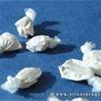
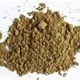
Heroin
appears as a white or brown powder

Slide 37
Heroin
opiate drug synthesized from morphine
can be injected, snorted/sniffed, or smoked

Slide 38
Street names for Heroin
Gear
Number 8
Chiva
Brownstone
Murder 1
Smack
China white
Dr. Feelgood
Dope
Junk (common to all "hard" drugs)
Caballo (Spanish slang)

Slide 39
Heroin Effects
Surge of euphoria (“rush”)
Dry mouth
Warm flushing of the skin
Heaviness of the extremities
Clouded mental functioning
User goes “on the nod,”
Cold Skin
Pinpoint pupils
Track marks
Brown colored area around the nose (sign of snorting)

Slide 40
Black Tar Heroin
mixture of dark orange and dark brown tones
less powdery form than heroin
“hashish-like” look & feel in appearance.

Slide 41
Black Tar Heroin
actually not heroin
synthesized from morphine,
created in a simpler way resulting in unrefined crude opium product.

Slide 42
Black Tar Heroin
Users at greater risk for life-threatening infections and vein collapse
Comes from Mexico
Impossible to distinguish between Heroin and Black Tar heroin in effects or symptoms.

Slide 43
Black Tar Heroin Street Names
Black
Brown
The letter "b" or "h"
Tar
Goma
Mexican mud
Muck
Pigment

Slide 44
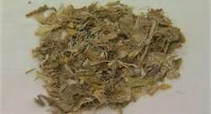
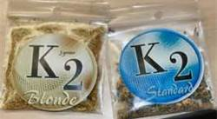
K2 or SPICE
Small, silvery plastic bags

Slide 45
K2 or SPICE
Herbs, spices or shredded plant material sprayed with synthetic compound
Marketed as incense that can be smoked
Resembles potpourri
Effects ten times more intense than marijuana.
Smoked or served in tea

Slide 46
K2 or SPICE
No marijuana Odor
Not detected with standard drug test

Slide 47
K2 Effects
dysphoria
severe paranoia
delusions
hallucinations
increased agitation
dizziness
difficulty walking
red, bloodshot eyes
smelly hair and clothes
short term memory loss
Acting silly for no apparent reason
loss of control
lack of pain response
pale skin
seizures
vomiting
profuse sweating
uncontrolled / spastic body movements
elevated blood pressure
heart rate and palpitations.

Slide 48
BATH SALTS
synthetic, stimulant powder product
contains amphetamine-like chemicals, including mephedrone
high risk for overdose

Slide 49
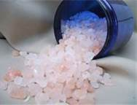
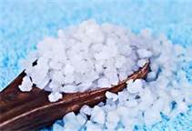
BATH SALTS
Resemble ordinary common bathing products
(made from mephodrone)

Slide 50
BATH SALTS EFFECTS
rapid heartbeat
high blood pressure
chest pains, agitation
hallucinations
extreme paranoia
delusions.

Slide 51
BATH SALTS NAMES
Blizzard
Blue Silk
Charge+
Ivory Snow
Ivory Wave
Ocean Burst
Pure Ivory
Snow Leopard
Stardust
Vanilla Sky
White Dove
White Knight
White Lightning

Slide 52
KETAMINE
dissociative anaesthetic similar to PCP
distorts users perception of sight and sound
anaesthetic properties used in human and veterinary medicine
"club drug“

Slide 53
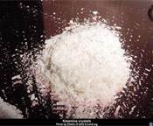
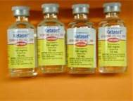
Liquid or Powder

Slide 54
KETAMINE USE
Intranasally
Orally
Injected

Slide 55
KETAMINE EFFECTS
Sense of floating and dissociation,
Stimulation,
Hallucinations.
“K-hole.” (almost sedated)
Severe respiratory depression
Muscle twitches
Dizziness
Slurred speech
Nausea,
Vomiting
Helpless confused state
Flashbacks
Amnesia
Delirium
Dramatic increase in heart rate
Loss of touch with reality
Loss of coordination
Flashbacks
Amnesia
Sense of invulnerability
Muscle rigidity
Aggressive/Violent behaviour
Death from overdose

Slide 56
KETAMINE STREET NAMES
Special K
Vitamin K
K
Super K
Ketaset
Jet
Super Acid
Green
Purple
Mauve
Special LA Coke

Slide 57
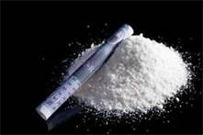
AMPHETAMINES
white, pale yellow, pale pink, brown, orange,
reddish powder or paste.

Slide 58
AMPHETAMINES
chemically similar to adrenaline
Three types
amphetamine sulphate (Speed or Benzedrine)
dextroamphetamine (Dexedrine)
methamphetamine (Methedrine)

Slide 59
AMPHETAMINE STREET NAMES
Bennies
Black beauties
Bumble bees
Co-pilots
Crank
Cross tops
Crystal meth
Dexies
Footballs
Hearts
Hot Ice
Ice
L.A. glass
Meth
MDMA (ecstasy)
Pep pills
Speed
Uppers

Slide 60
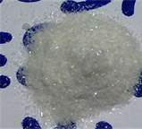
Crystal Meth
Resembles a piece of ice
Large crystals or rocks

Slide 61
Crystal Meth
Made using ephedrine or pseudoephedrine
smokeable freebase form of meth-amphetamine
originated from Hawaii

Slide 62
Methods of Use
Smoked in pipe
Injected
Snorted
Swallowed
Inserted in anus or urethra

Slide 63
Crystal Meth Effects
Euphoria
Increased energy/alertness
Diarrhea
Nausea
Excessive sweating
Loss of appetite
Insomnia
Tremors
Jaw-clenching
Agitation
Irritability
Talkativeness
Panic
compulsive fascination with repetitive tasks
violence
confusion
Increased libido
Increased blood pressure
Increased body temperature
Increased heart rate
Increased blood sugar levels
Constriction of artery walls

Slide 64
Long Term Use Effects
Tolerance (addiction)
Depression and anhedonia
"Meth Mouth"
Drug-related psychosis
Brain damage
Sensation of flesh crawling
Paranoia
Hallucinations
Delusions
Tension headache
Muscle breakdown
Kidney damage or failure
Death

Slide 65
Street Names
Batu
Black Beauties
Chalk
Crank
Crystal
Glass
Hanyak
Ice
L.A. Ice
Methlies Quick
Quartz
Speed
Super Ice
Yellow Bam
Uppers
Trash
Biker's Coffee
Blade
Chicken Feed
Cristy
Crystal Glass
Go-Fast
Hot Ice
Yaba
Meth
Poor Man's Cocaine
Stove Top
Shards
Tina
Tweak
L.A. Glass

Slide 66
PRUNO/HOOCH
Prison Wine
Made with fruits, bread, ketchup, sugar, other materials added for flavor
Name comes from original use of fermented prunes

Slide 67
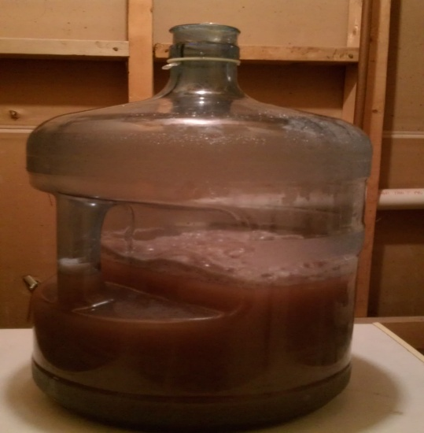
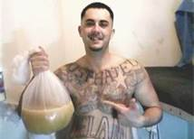
PRUNO/HOOCH
PRIMARY INGREDIENTS ARE FRUIT, BREAD AND SUGAR

Slide 68
SIGNS OF DRUNKENNESS
smelling of alcohol,
involuntary eye movements,
bloodshot eyes,
difficulty standing,
swaying and staggering,
vomiting,
making inappropriate sexual advances,
bumping into things,
falling down,
inability to sit straight,
violent behavior, carelessness,
clumsiness and sleepiness.
overly happy
showing bravado,
crude
argumentative without warning.

Slide 69
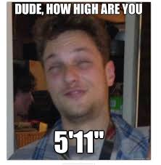
How do I tell if he is high

Slide 70
12 Steps
Look into the person's eyes
Smell the person.
Observe the person's mouth.
Observe the person's nose
Observe the person's hands.
Check the person's vital signs.

Slide 71
12 Steps
Check for signs of habitual drug use.
Check for drug paraphernalia.
Listen to the person's speech.
Observe the person's movements.
Note unusual or shifting energy.
Keep an eye out for unusual actions.

Slide 72
Guided Practice
In your group complete the puzzle on the poster size paper.
Hang your poster on your easel pad when complete.
You have 15 minutes.

Slide 73
Independent Practice
Individually answer quiz questions
Select spokesperson
You have 10 minutes

Slide 74
PERFORMANCE OBJECTIVES
Using the information provided identify illicit substances according to the effects and appearance of each substance.
Given offender behaviors, identify the illicit substance which causes the behavior, according to the information in the manual.

